Slide 1
Unit 3
Chapter 6
Lesson 1
Day 3
Pages 154-159

Slide 2

Writing Roulette
Working with your partner, write a summary of the French and Indian War. You can’t talk and you have to take turns writing every other word. You have two minutes to write your summary.

Slide 3
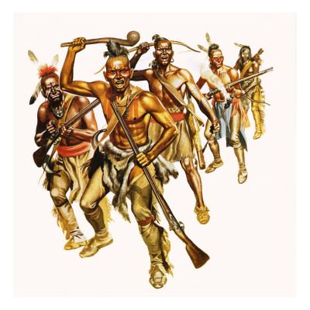
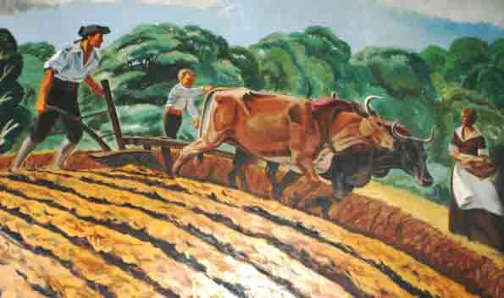
Knowing that there could be trouble with Native Americans still living in the new area now controlled by England, Parliament needed a way to control their colonists and new territory.

Slide 4
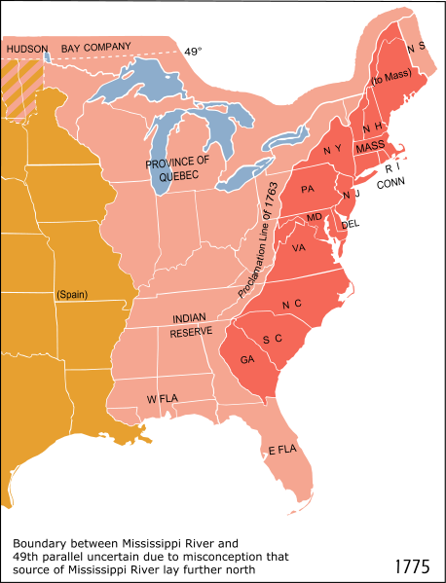
The Proclamation of 1763 was given which created a line along the frontier. Colonists were not to settle on land west of the Proclamation Line of 1763.

Slide 5
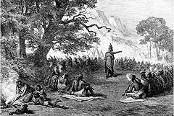
Native Americans living in the Great Lakes region and Ohio River Valley did not like the way they were being treated by the British and were afraid their land would be taken away.

Slide 6
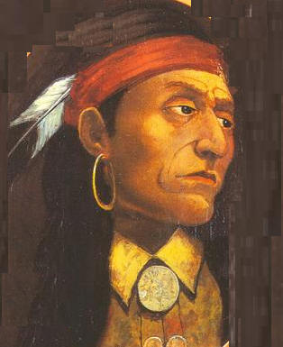
Many Native American tribes joined together to fight the British and colonists. One of the main leaders was an Ottawa named Pontiac. The fighting that followed is called Pontiac’s War or Pontiac’s Rebellion.

Slide 7
Big Time Biography
Read the biography about Pontiac on pg.159 in your social studies textbook and answer the following question. How did Pontiac’s ability to persuade people help him organize a rebellion?

Slide 8
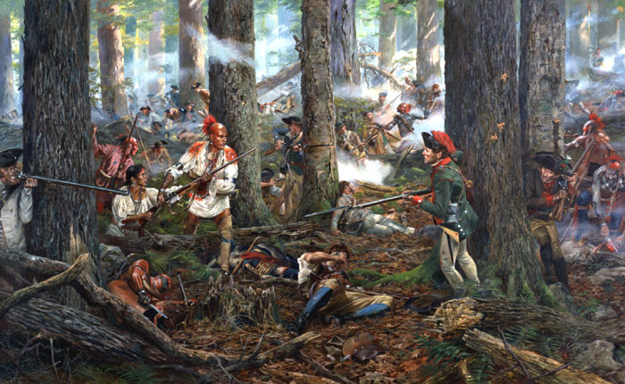
Native American warriors attacked forts, destroyed farms in the frontier, and killed many colonists living on the frontier.

Slide 9
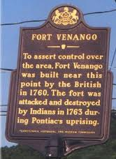
Fort Venango (Franklin) and Fort Le Boeuf (Waterford) were captured by Native Americans in June of 1763.

Slide 10
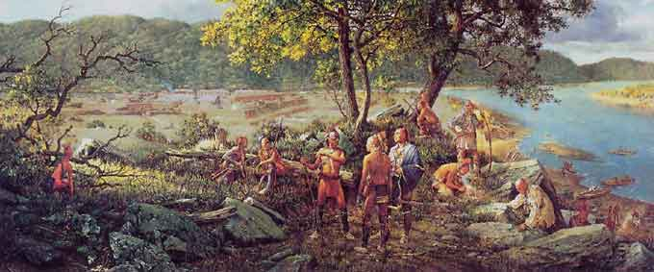
Fort Pitt was attacked by Delaware Indians on June 22,1763. They couldn’t capture the fort, so they laid siege to it.

Slide 11
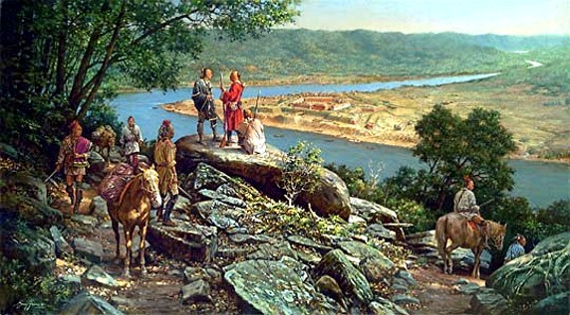
Many people from the area had fled to Fort Pitt for protection from Native American raids. The fort normally only held 300 people. During the siege, over 1,500 people sought shelter there.

Slide 12
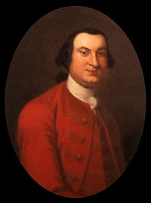
Colonel Henry Bouquet of Lancaster, along with 500 soldiers were sent to relieve Fort Pitt. The Delawares laying siege to the fort left it to attack Bouquet’s men.

Slide 13
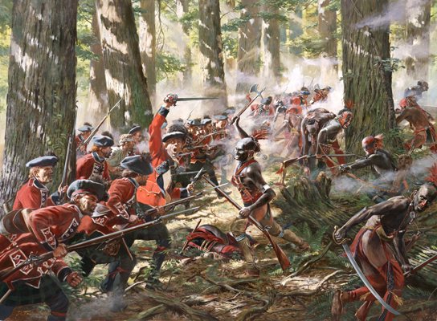
The two forces clashed on August 5, 1763, and fought the Battle of Bushy Run for two days.

Slide 14
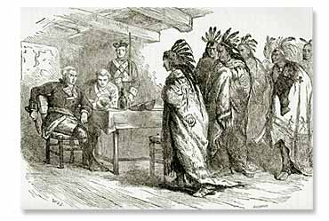
Bouquet and his men won, relieved Fort Pitt, and ended Pontiac’s War in Pennsylvania and the surrounding area. The war officially ended on July 25, 1766.

Slide 15
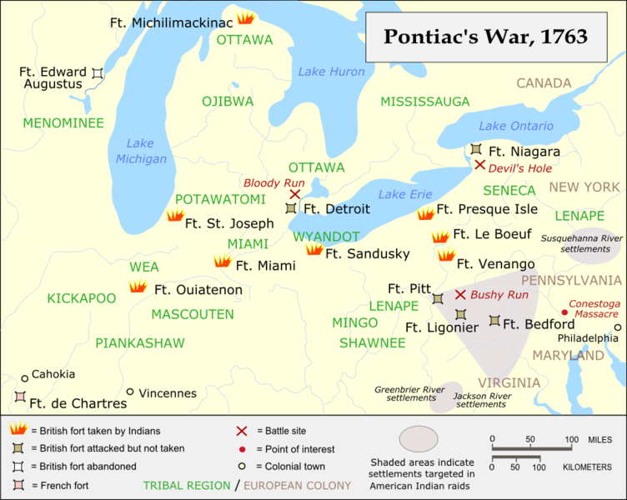

Slide 16
Cinquain
Use the following format to write a cinquain poem about Pontiac’s Rebellion.
Line 1- one word/ subject
Line 2- two adjectives describing line one
Line 3- three action verbs that relate to line one
Line 4- a four-word sentence that relates to line one
Line 5- one word that is a synonym of line one

Slide 17
Example of a Cinquain
Students
Inquisitive, thoughtful
Reading, writing, thinking
Working hard to succeed
Pupils

